Slide 1

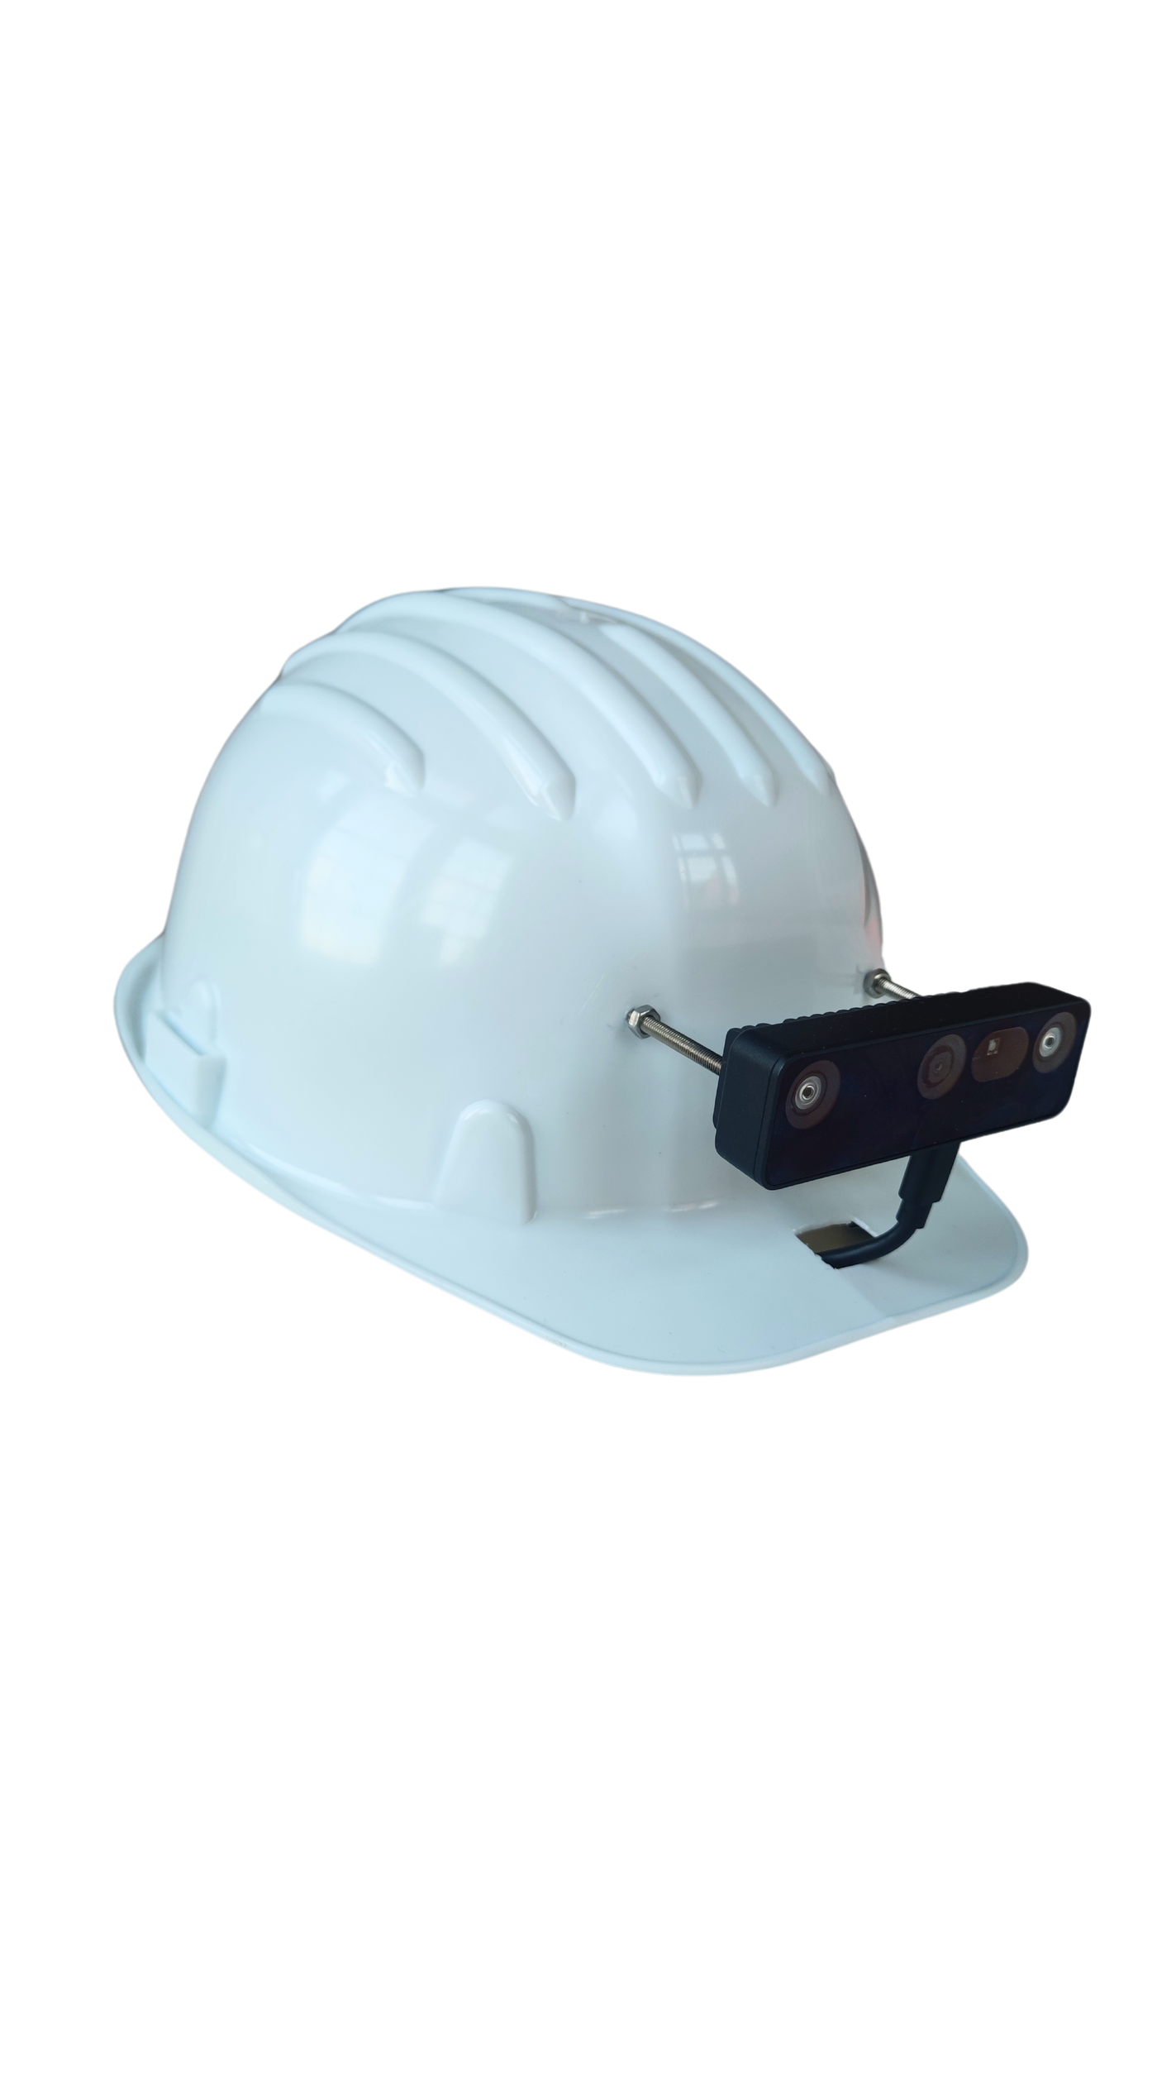



PAOLO MAGRI
MATTIA SAPUTO
LORENZO TURLA
2023-2024
DEPTH-SENSE HELMET
Prosthesis Vision Assistance for Visually

Slide 2
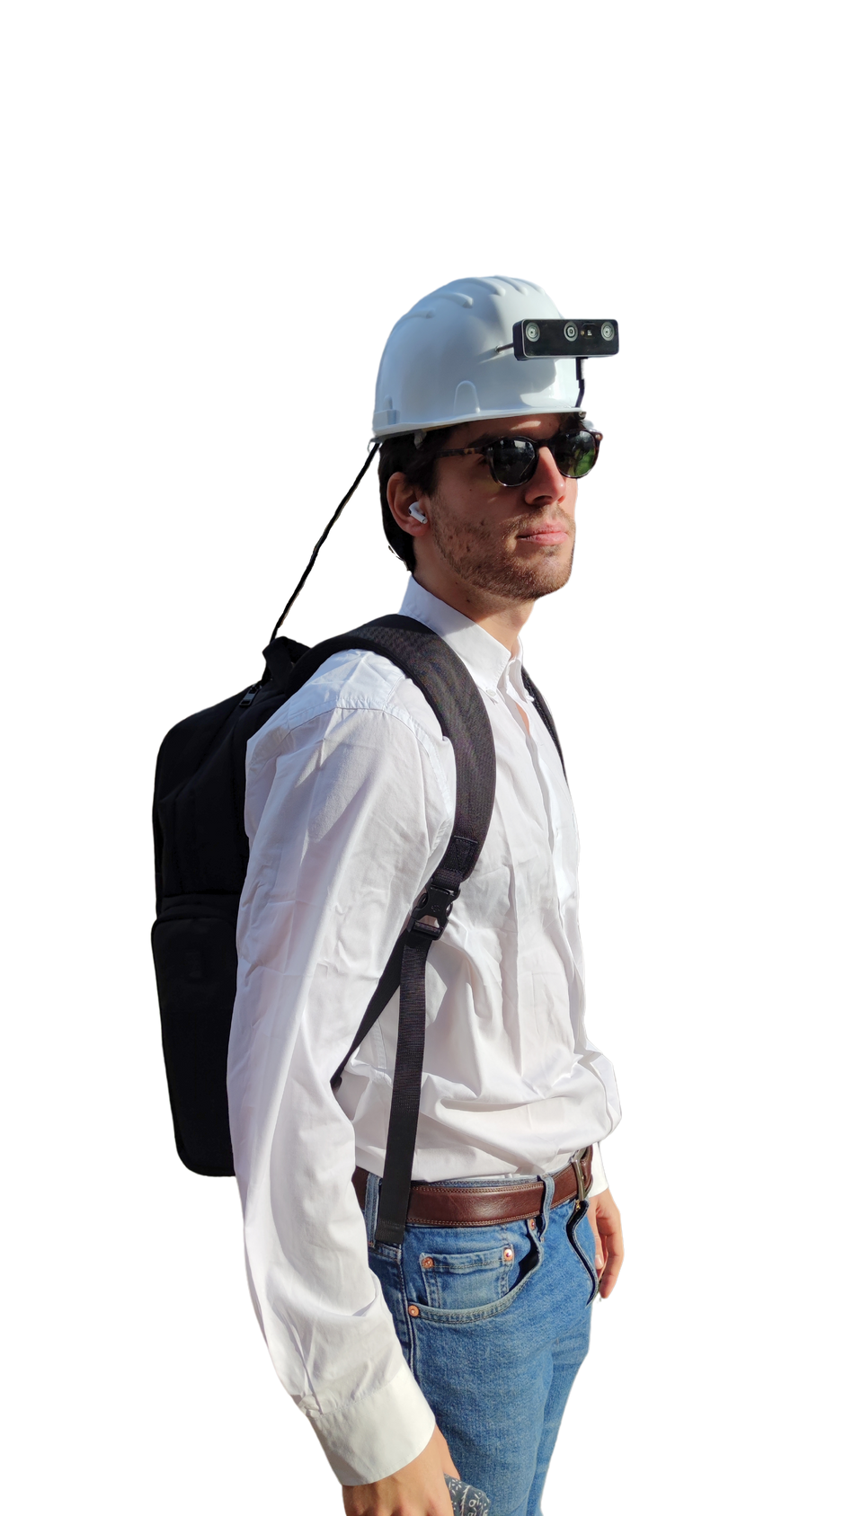
OVERVIEW
01
Helmet equipped with a camera featuring depth sensor and object detection
02
Connection via USB port to the computer placed in the backpack
03
Connected with ear-pods featuring transparency mode to not limit listening

Slide 3
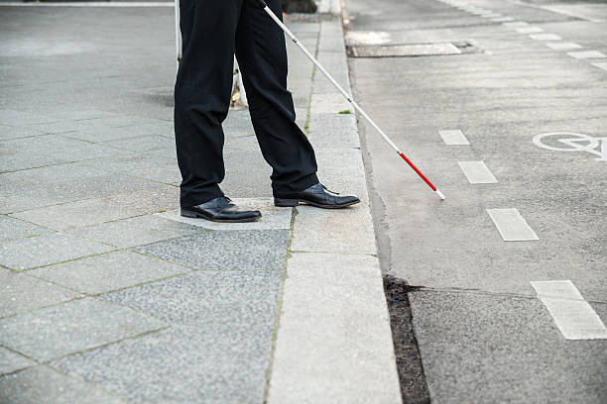
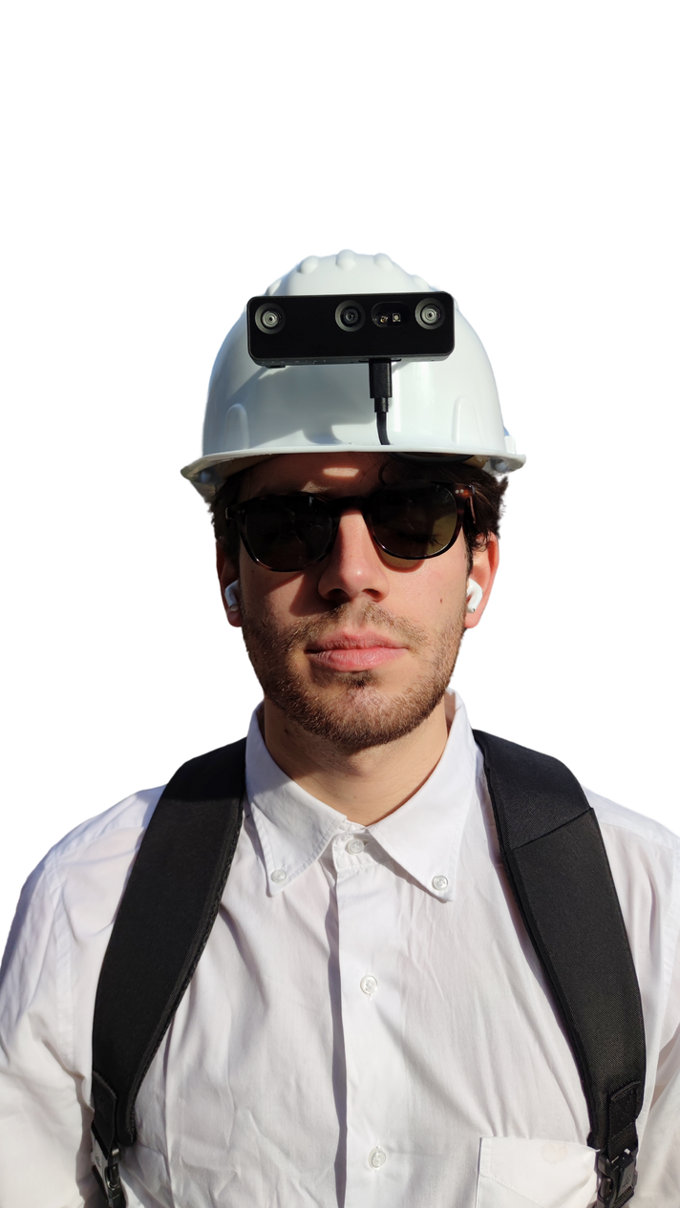
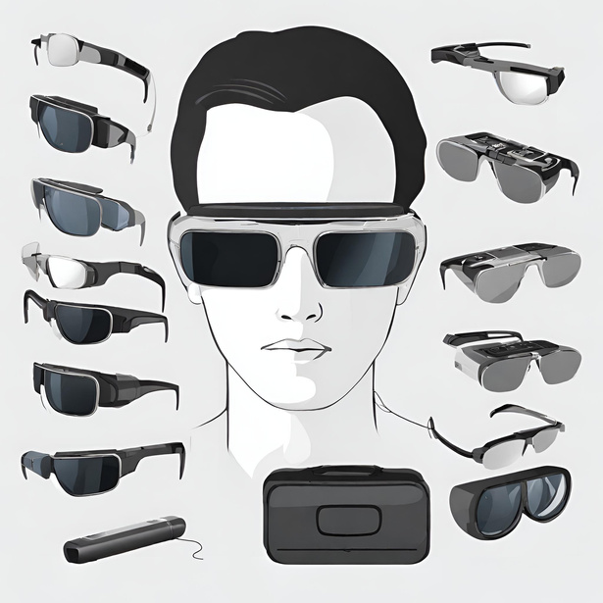
PROGRESS
OLD SOLUTION
OUR SOLUTION
FUTURE SOLUTION
Limited Distances
Touch needed
Hands-Free
Object Recognition
New tasks
Greater Comfort

Slide 4
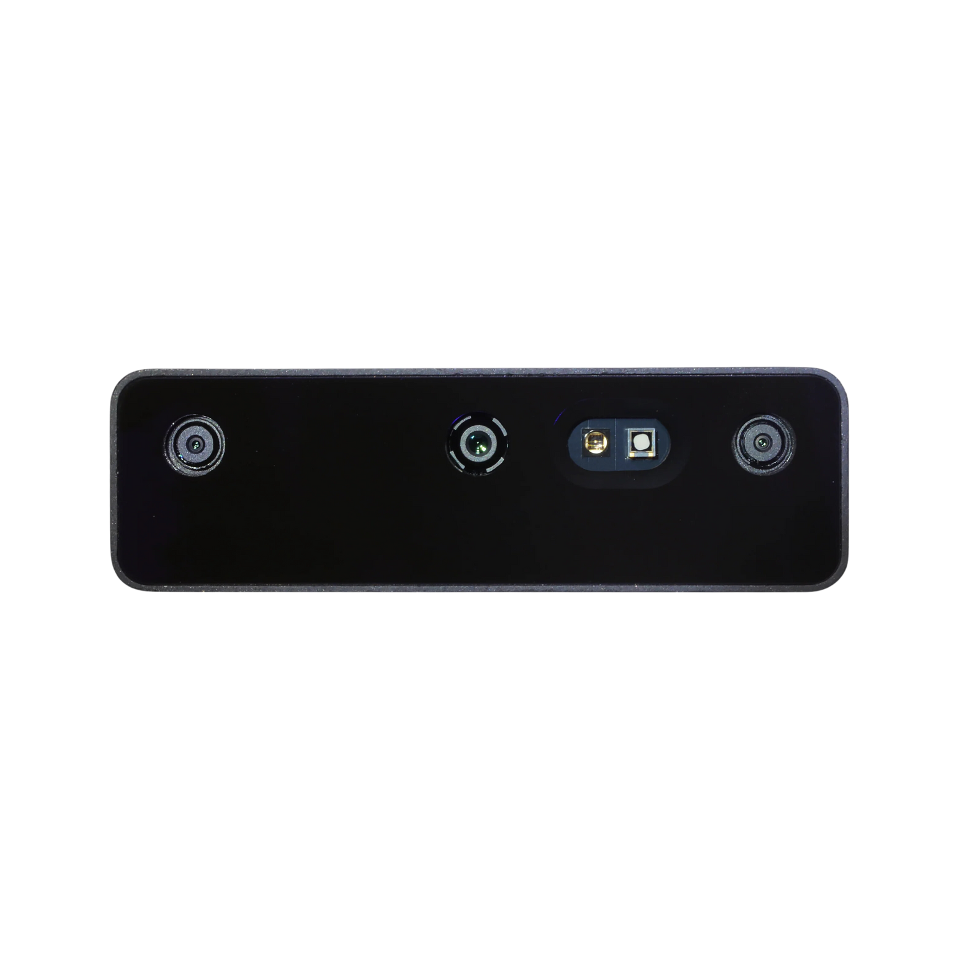
CAMERA
OAK-D PRO
RGB
DEPTH
NIGHT VISION
12MP central RGB camera auto-focus and fixed-focus variants
Depht perception for low visual intrest surface by projecting thousands of IR dots to the scene
IR illumination LED enables running AI and CV algorithms in low-light or no-light environments

Slide 5
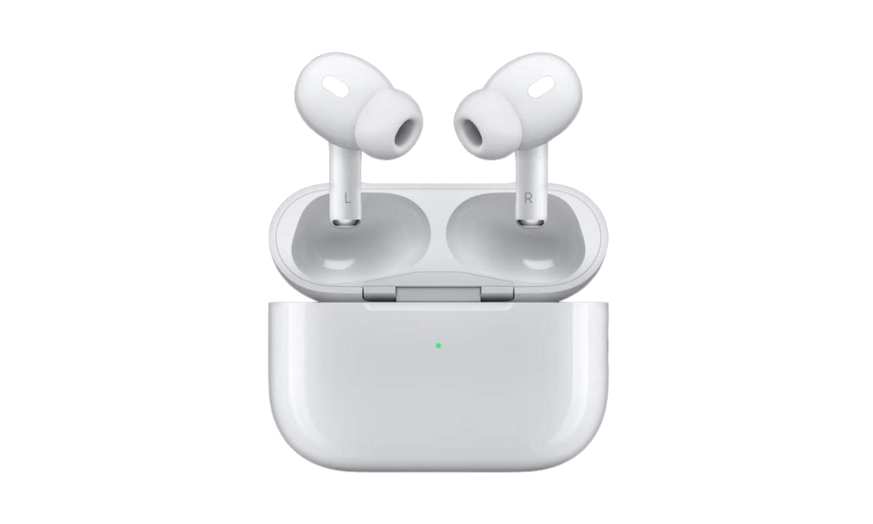
AIR-PODS PRO
AUDIO PANNING
TRASPARENCY MODE
User could be aware if the obstacle is at left or at right and secondly
Listen feedback sounds at the same time to be careful of the environment

Slide 6
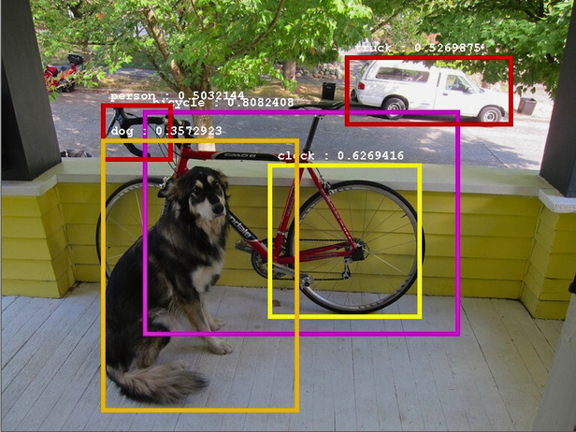
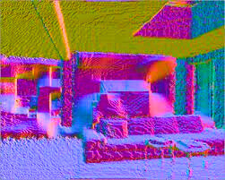
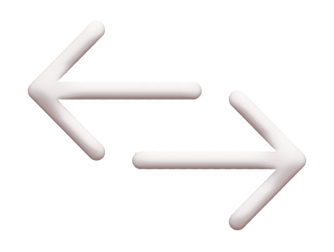
ALGORITHMS
OBJECT DETECTION
DEPTH ANALYSIS
YOLO v4
realtime object detection
STEREO CAMERA
sensor fusion

Slide 7
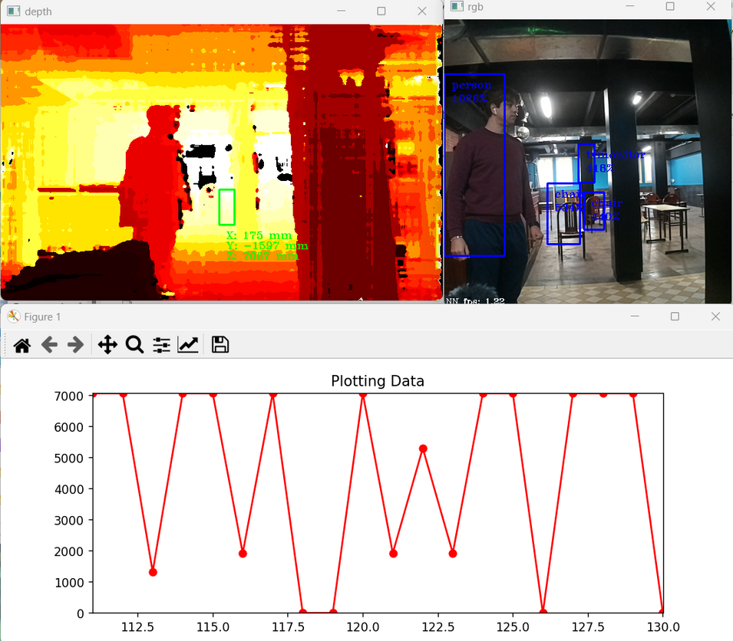



DEPTH ANALYZER
Three different sound frequencies based on the distance of the object
3m - 2m - 1m
Distance plot for recalibration according to personal preferences
Stereo fusion between two monocular depth cameras
Wide visual range of up to 10 meters

Slide 8

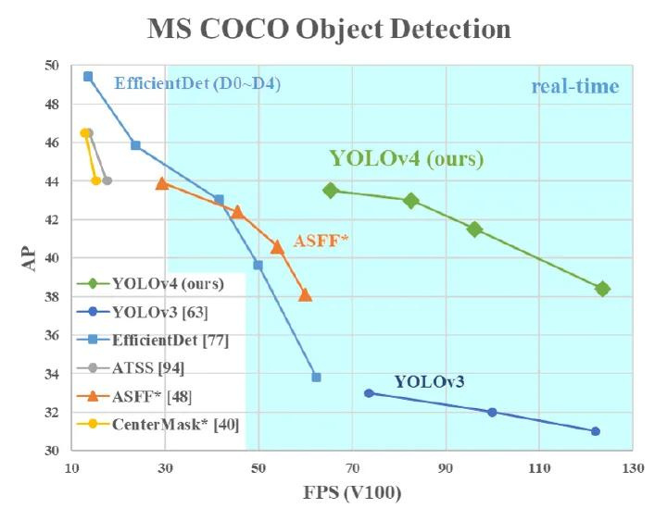

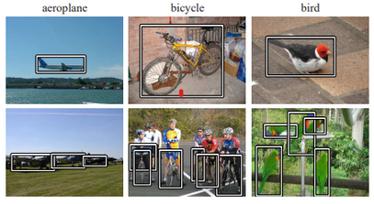
OBJECT DETECTION
YOLO v4
Automatic creation of different ROIs and nearest one priority
Expandable and customizable dataset for object and human recognition

Slide 9


USER TRAINING
TWO-PHASES
01
02
Dynamic Phase:
Moving Subject Recognizing Distances and Getting Accustomed to Sound Frequency Differences
Initial Phase:
Object and Shape Recognition in Static Positions

Slide 10

FUTURE IMPLEMENTATIONS
01
Algorithm reading implementation
02
Implementation of an Arduino board with battery
03
Controller for tasks, zoom, contrast, and also lighting in low-light conditions

Slide 11




PROBLEMS
The computational power of the computer that slows down real-time acquisition
Difficulty in recognizing objects not present in the dataset
Limitations in acquisition quality due to camera resolution and algorithms

Slide 12

2023-2024
THANK YOU
CONTACT US FOR MORE DETAILS
PAOLO MAGRI
MATTIA SAPUTO
LORENZO TURLA
p.magri005@studenti.unibs.it
m.saputo001@studenti.unibs.it
l.turla002@studenti.unibs.it

